Slide 1
Visual Captioning From Visual Content to Sentences
Hongzhi Li
Computer Science Department, Columbia University

Slide 2
Visual Captioning
Kiros, Ryan, Ruslan Salakhutdinov, and Richard S. Zemel. "Unifying visual-semantic embeddings with multimodal neural language models." arXiv preprint arXiv:1411.2539 (2014).

Slide 3
Problem Formulation
Find or generate text description for a given image
Find sentence(s) from a sentence database to describe the given image
Generate sentence(s) based on the content of the given image

Slide 4
General Solution/Framework
Human Knowledge / Experience
Computer Vision Component
Language Model
Context of Image
Generate
Human Knowledge / Experience
Similarity Measurement
Text Description
Select
Context of Image
Sentence Corpus

Slide 5
Paper Selection
The selected papers are summarized into the following categories:
Image-Sentence Embedding
Caption transferring
Sentence synthesis

Slide 6
Benchmarks
The popular benchmarks are Flickr 8k and Flickr 30k dateset
Flickr 8k: a benchmark collection for sentence-based image description and search, consisting of 8,000 images that are each paired with five different captions which provide clear descriptions of the salient entities and events.
Flickr 30K: This is an extension of Flickr 8k Dataset. The new images and captions focus on people involved in everyday activities and events. The image caption corpus consisting of 158,915 crowd-sourced captions describing 31,783 images.
Other dataset: IAPR TC-12 (Grubinger et al. (2006)), MS COCO (Lin et al. (2014)) and etc.

Slide 7
Performance Measurement
Retrieval task
Each image has 5 ground truth sentence annotations
For explanation task, given the image as query, return the ranked list of sentences
For the illustration task, given the sentence as query, return the ranked list of images.
Measure: recall @ 1, 5, 10 and median rank
Sentence generation task
Measure: BLEU-1, BLEU-2, BLEU-3 score, perplexity (PPL) score

Slide 8
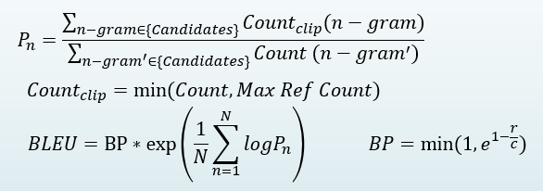
Performance Measurement
BLEU uses a modified form of precision to compare a candidate translation against multiple reference translations.
Example:
$$P_{n}=\frac{\sum_{n−gram∈\{Candidates\}}{{Count}_{clip}(n−gram)}}{\sum_{{n−gram}^{′}∈\{Candidates\}}{Count ({n−gram}^{′})}}$$
$${Count}_{clip}=min⁡(Count, Max Ref Count)$$
$$BLEU=BP∗\exp\left(\frac{1}{N}\sum_{n=1}^{N}{logP_{n}}\right)$$
$$BP=min⁡(1,e^{1−\frac{r}{c}})$$
Candidate: the the the the the the the
Reference 1: The cat is on the mat
Reference 2: There is a cat on the mat
Papineni, Kishore, Salim Roukos, Todd Ward, and Wei-Jing Zhu. "BLEU: a method for automatic evaluation of machine translation." ACL2002.

Slide 9
Perplexity
Evaluation of quality of different language models is usually done by using perplexity.
The perplexity (PPL) of word sequence w is defined as

Slide 10
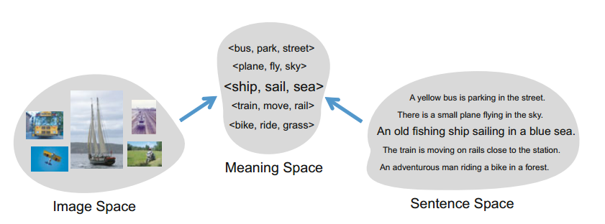
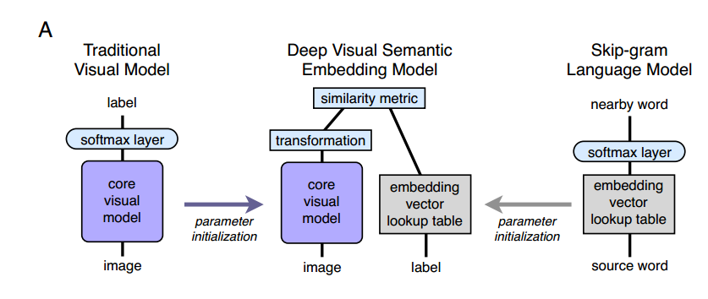
Image-Sentence Embedding
The idea is to map image and sentence into a common space, so that we can compare the similarity of image and sentence
How to design the common space?

Slide 11
Image-Sentence Embedding
Common Space is represented as triplets of <object, action, scene>
Farhadi, Ali, Mohsen Hejrati, Mohammad Amin Sadeghi, Peter Young, Cyrus Rashtchian, Julia Hockenmaier, and David Forsyth. "Every picture tells a story: Generating sentences from images.” ECCV 2010

Slide 12
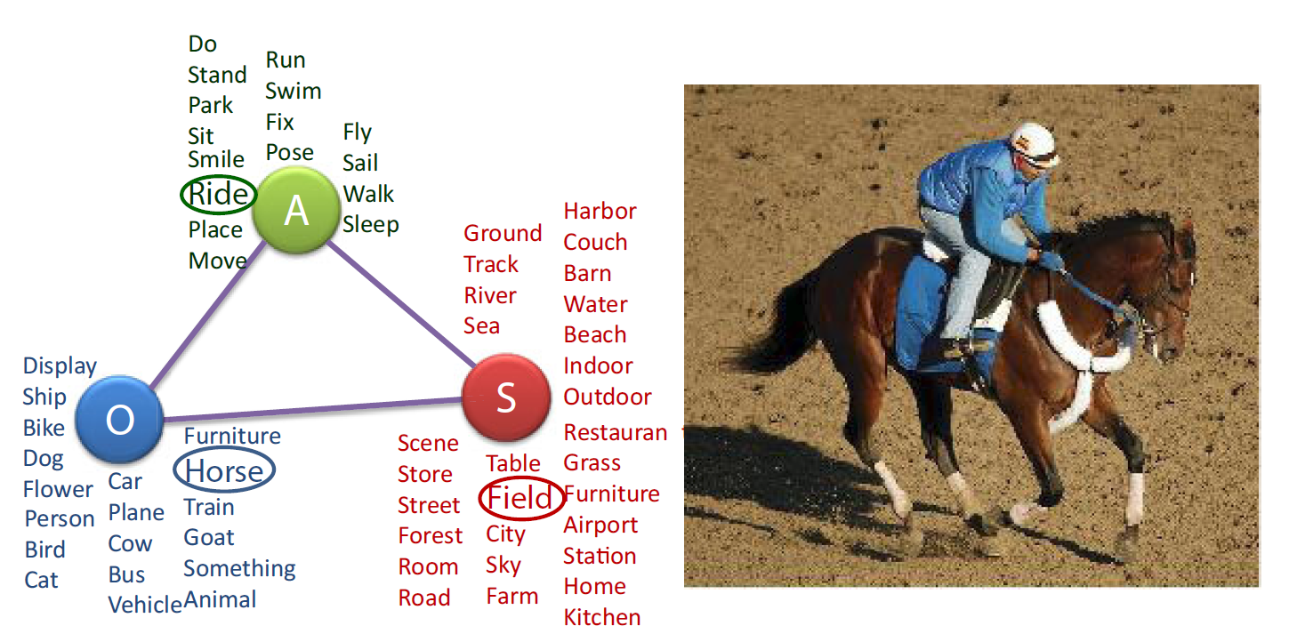
Image-Sentence Embedding
Mapping to Meaning Space:
Mapping image to meaning space: object & scene detector
Mapping sentence to meaning space: generate a dependency parse for each sentence
Similarity:
Lin Similarity Measure for Objects and Scenes
Action Co-occurrence Score

Slide 13
Image-Sentence Embedding
Some results:
Limitation:
Performance highly depends on object detection and classification output, low performance on the out of domain visual concept

Slide 14
Image-Sentence Embedding
Embedding is learned from Neural Network model
Frome, Andrea, Greg S. Corrado, Jon Shlens, Samy Bengio, Jeff Dean, and Tomas Mikolov. "Devise: A deep visual-semantic embedding model." InAdvances in Neural Information Processing Systems, pp. 2121-2129. 2013.

Slide 15
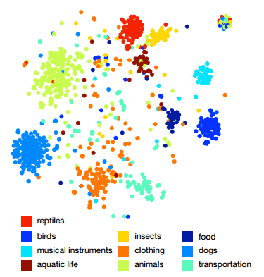
Skip-Gram Language Model
Learn semantically-meaningful floating point representations of terms from unannotated text
The model learns to represent each term as a fixed length embedding vector by predicting adjacent terms in the document
Mikolov, Tomas, Kai Chen, Greg Corrado, and Jeffrey Dean. "Efficient estimation of word representations in vector space." arXiv preprint arXiv:1301.3781 (2013).

Slide 16
Skip-Gram Language Model
The training objective of the Skip-gram model is to find word representations that are useful for predicting the surrounding words in a sentence or a document.
Given a sequence of training words $w_{1}, w_{2}, w_{3}…w_{T}$the objective of the Skip-gram model is to maximize the average log probability: $\frac{1}{T}\sum_{t=1}^{T}{\sum_{−c≤j≤c, j≠0}{logp(w_{t+j}|w_{t})}}$, where c is the size of the training context
The projection learned from skip-gram model could be used to compute the vector representations of a single word.
Mikolov, Tomas, Ilya Sutskever, Kai Chen, Greg S. Corrado, and Jeff Dean. "Distributed representations of words and phrases and their compositionality." NIPS. 2013.

Slide 17
Image-Sentence Embedding
Visual Model: AlexNET trained for the 1,000-class ImageNet Large Scale Visual Recognition Challenge (ILSVRC) 2012
Text Model: skip-gram text model
Loss function used to train the embedding model:
M is the matrix of trainable parameters
Frome, Andrea, Greg S. Corrado, Jon Shlens, Samy Bengio, Jeff Dean, and Tomas Mikolov. "Devise: A deep visual-semantic embedding model." InAdvances in Neural Information Processing Systems, pp. 2121-2129. 2013.

Slide 18
Evaluation
Evaluation on Flickr 8K dataset
Notes:
[30] Socher, Richard, Q. Le, C. Manning, and A. Ng. "Grounded Compositional Semantics for Finding and Describing Images with Sentences." In NIPS Deep Learning Workshop. 2013.
[15] Karpathy, Andrej, Armand Joulin, and Li Fei-Fei. "Deep fragment embeddings for bidirectional image sentence mapping." arXiv preprint arXiv:1406.5679(2014).

Slide 19
Image-Sentence Embedding
Define a common space
Map the image to the common space
Map the text to the common space
Compare the similarity of image and text in the common space
Solve the image captioning problem by select sentence(s) from a pre-built sentence database to describe an image

Slide 20
Image-Sentence Embedding
The pipeline:
Embedding
Similarity
Image
Selected Sentence as Description of the Image
Text
(candidacy sentence dataset)

Slide 21
Analysis on Image-Sentence Embedding
The entire framework relies highly on the image analysis model.
Issues of the traditional object detection method:
How to define the object ontology
Unsatisfactory object detection accuracy
Cross domain issue
The success of neural network methods helped to solve some of issues in the traditional object detection methods, but the overall performance is still quite limited due to the simple text model
Limitation of pre-generated sentence database

Slide 22
Extension of Image-Sentence Embedding
Instead of using pre-trained visual model and text model, can we train the multimodal neural network to predict the visual-text similarity?
BOW text model ignored sequence information in a sentence. If more advanced text model may help.
A better reference dataset?
Instead of having text information only, can we use visual & text information together?

Slide 23
Caption Transferring
Ordonez, Vicente, Girish Kulkarni, and Tamara L. Berg. "Im2text: Describing images using 1 million captioned photographs." In Advances in Neural Information Processing Systems, pp. 1143-1151. 2011.

Slide 24
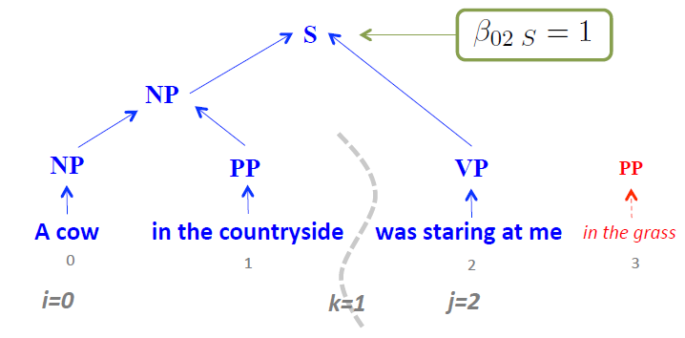
Caption Transferring
Syntactic model based sentence generation
Kuznetsova, Polina, Vicente Ordonez, Tamara L. Berg, U. C. Hill, and Yejin Choi. "Treetalk: Composition and compression of trees for image descriptions.“ TACL (2014)

Slide 25
Caption Transferring
Build a large captioned image dataset
Given a query image, find the visual similar image from the dataset.
Transfer the captions of the selected images to the query image as its caption
Compare to “Image-Sentence Embedding” method, caption transferring method compare visual similarity instead of “visual-text” similarity.
It’s easy to build the reference dataset by crawling web images and their captions.

Slide 26
Sentence Synthesis
Template based sentence generation
Recurrent neural network based language model

Slide 27
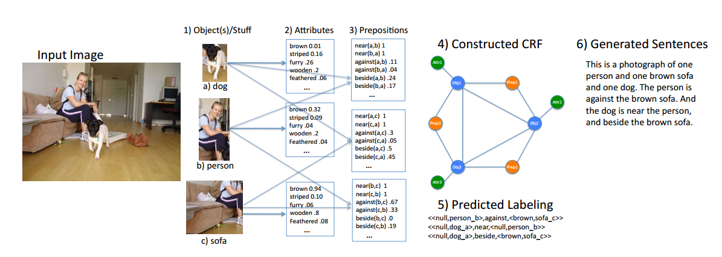
Sentence Synthesis
Template based sentence generation
Kulkarni, Girish, Visruth Premraj, Sagnik Dhar, Siming Li, Yejin Choi, Alexander C. Berg, and Tamara L. Berg. "Baby talk: Understanding and generating simple image descriptions." CVPR 2011

Slide 28
Conditional Random Field
Minimize an energy function over labels (L) of an image (I), text prior (T).

Slide 29
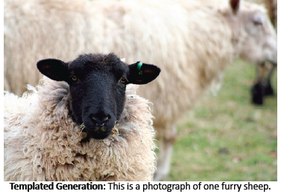
Sentence Synthesis
Image is labeled as:
<attribute, object/stuff> preposition <attribute, object/stuff>
<attribute, object/stuff> is extended to phrase
Template is used to generate descriptive language, e.g.
This is a photograph of [<attribute,object/stuff> phrase]
Here we see [<attribute,object/stuff1> phrase], [<attribute,object/stuff2> phrase], and [<attribute,object/stuff3> phrase]. [<attribute,object/stuff1> phrase] is [preposition] [<attribute,object/stuff2> phrase]. ……
This is a photograph of one furry sheep

Slide 30
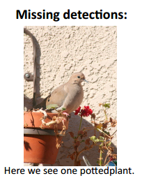
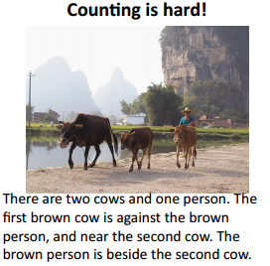
Sentence Synthesis
This approach still suffers from the object detection error

Slide 31
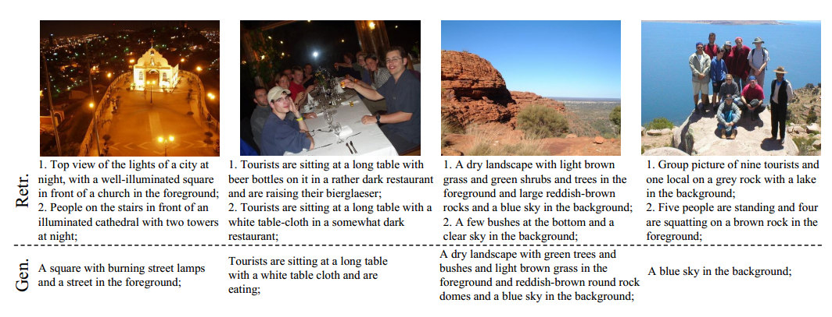
Sentence Synthesis
Image caption generation by multimodal recurrent neural network
Mao, Junhua, Wei Xu, Yi Yang, Jiang Wang, and Alan L. Yuille. "Explain images with multimodal recurrent neural networks." arXiv preprint arXiv:1410.1090 (2014).

Slide 32
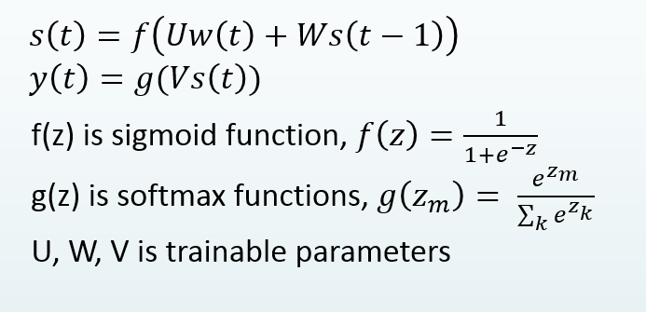
Recurrent Neural Network based Language Model (Text only)
$$s\left(t\right)=f\left(Uw\left(t\right)+Ws\left(t−1\right)\right)$$
$$y\left(t\right)=g(Vs\left(t\right))$$
Input word
f(z) is sigmoid function, $f\left(z\right)=\frac{1}{1+e^{−z}}$
g(z) is softmax functions, $g\left(z_{m}\right)= \frac{e^{z_{m}}}{\sum_{k}{e^{z_{k}}}}$
U, W, V is trainable parameters
Output: probability of next word

Slide 33
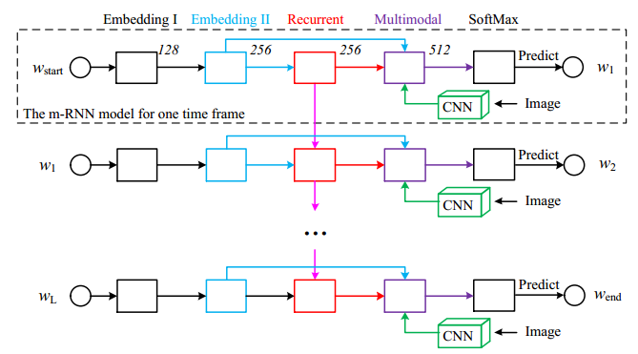
Multimodal Recurrent Neural Network
Image caption generation by multimodal recurrent neural network
Network Definition:
“CNN” is pre-trained AlexNET.
RNN network is defined as
r(t-1)
m(t)
w(t)
r(t)
I
Mao, Junhua, Wei Xu, Yi Yang, Jiang Wang, and Alan L. Yuille. "Explain images with multimodal recurrent neural networks." arXiv preprint arXiv:1410.1090 (2014).

Slide 34
Training the m-RNN
Cost Function:
BackPropagation algorithm is used to learn the model parameters

Slide 35
Performance Analysis

Slide 36
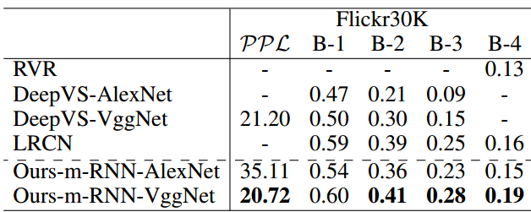
Performance Analysis
Chen, Xinlei, and C. Lawrence Zitnick. "Learning a Recurrent Visual Representation for Image Caption Generation." arXiv preprint arXiv:1411.5654(2014).
Notes:
DeepVS: Karpathy, Andrej, and Li Fei-Fei. "Deep visual-semantic alignments for generating image descriptions." arXiv preprint arXiv:1412.2306 (2014).
LRCN: Donahue, Jeff, Lisa Anne Hendricks, Sergio Guadarrama, Marcus Rohrbach, Subhashini Venugopalan, Kate Saenko, and Trevor Darrell. "Long-term recurrent convolutional networks for visual recognition and description." arXiv preprint arXiv:1411.4389 (2014).
RVR:

Slide 37
Some Examples
Good!
Bad!

Slide 38
Sentence Synthesis
Language model based caption generation is considered as the state-of-the-art method to solve image captioning problem. (RNN, Log-Bilinear Model and etc.)
Convolutional neural network is used to analyze the image content.
The performance of CNN matters!

Slide 39
Analysis of Sentence Synthesis
RNN based language model have significantly improvement comparing to the embedding model
But, we still cannot generate various captions e.g.
For different purpose (e.g. emotion/sentiment)
For different image context (prior knowledge)
Training the model is not easy
Long training time
Tons of engineering tricks
Not easy to understand the “inside” of RNN and how to control it to generate different content

Slide 40
Analysis of Sentence Synthesis
It’s not clear how multimodal rnn or other multimodal language models work
Language model itself is an active research field in NLP community, is there a better way to combine text and visual model other then linear combination
The evaluation is sort of unfair
Given 5 human annotated sentences as ground truth for each image, and Every word is treated equally. (“this is a cat” v.s. “this is a dog”)
Subjective evaluation is necessary, but very expensive
Any better evaluation method?

Slide 41
Visual Captioning
Visual content analysis:
Object detection and classification
Convolutional neural network
Visual-Text similarity
embedding space
Caption generation
Template/Syntactic based language generation
Recurrent neural network based language model

Slide 42
Reference:
Farhadi, Ali, Mohsen Hejrati, Mohammad Amin Sadeghi, Peter Young, Cyrus Rashtchian, Julia Hockenmaier, and David Forsyth. "Every picture tells a story: Generating sentences from images." In Computer Vision–ECCV 2010, pp. 15-29. Springer Berlin Heidelberg, 2010.
Karpathy, Andrej, Armand Joulin, and Li Fei-Fei. "Deep fragment embeddings for bidirectional image sentence mapping." arXiv preprint arXiv:1406.5679(2014).
Zitnick, C. Lawrence, Devi Parikh, and Lucy Vanderwende. "Learning the visual interpretation of sentences." In Computer Vision (ICCV), 2013 IEEE International Conference on, pp. 1681-1688. IEEE, 2013.
Zitnick, C. Lawrence, and Devi Parikh. "Bringing semantics into focus using visual abstraction." In Computer Vision and Pattern Recognition (CVPR), 2013 IEEE Conference on, pp. 3009-3016. IEEE, 2013.
Frome, Andrea, Greg S. Corrado, Jon Shlens, Samy Bengio, Jeff Dean, and Tomas Mikolov. "Devise: A deep visual-semantic embedding model." In Advances in Neural Information Processing Systems, pp. 2121-2129. 2013.

Slide 43
Reference:
Gong, Yunchao, Liwei Wang, Micah Hodosh, Julia Hockenmaier, and Svetlana Lazebnik. "Improving image-sentence embeddings using large weakly annotated photo collections." In Computer Vision–ECCV 2014, pp. 529-545. Springer International Publishing, 2014.
Gong, Yunchao, Qifa Ke, Michael Isard, and Svetlana Lazebnik. "A multi-view embedding space for modeling internet images, tags, and their semantics."International Journal of Computer Vision 106, no. 2 (2014): 210-233.
Kiela, Douwe, and Léon Bottou. "Learning Image Embeddings using Convolutional Neural Networks for Improved Multi-Modal Semantics." InProceedings of the 2014 Conference on Empirical Methods in Natural Language Processing (EMNLP), pp. 36-45. 2014.
Hodosh, Micah, Peter Young, and Julia Hockenmaier. "Framing Image Description as a Ranking Task: Data, Models and Evaluation Metrics." J. Artif. Intell. Res.(JAIR) 47 (2013): 853-899.
Kulkarni, Girish, Visruth Premraj, Sagnik Dhar, Siming Li, Yejin Choi, Alexander C. Berg, and Tamara L. Berg. "Baby talk: Understanding and generating simple image descriptions." In Computer Vision and Pattern Recognition (CVPR), 2011 IEEE Conference on, pp. 1601-1608. IEEE, 2011.

Slide 44
Reference:
Yang, Yezhou, Ching Lik Teo, Hal Daumé III, and Yiannis Aloimonos. "Corpus-guided sentence generation of natural images." In Proceedings of the Conference on Empirical Methods in Natural Language Processing, pp. 444-454. Association for Computational Linguistics, 2011.
Li, Siming, Girish Kulkarni, Tamara L. Berg, Alexander C. Berg, and Yejin Choi. "Composing simple image descriptions using web-scale n-grams." InProceedings of the Fifteenth Conference on Computational Natural Language Learning, pp. 220-228. Association for Computational Linguistics, 2011.
Kuznetsova, Polina, Vicente Ordonez, Tamara L. Berg, and Yejin Choi. "Treetalk: Composition and compression of trees for image descriptions."Transactions of the Association for Computational Linguistics 2, no. 10 (2014): 351-362.
Kuznetsova, Polina, Vicente Ordonez, Alexander C. Berg, Tamara L. Berg, and Yejin Choi. "Generalizing Image Captions for Image-Text Parallel Corpus." InACL (2), pp. 790-796. 2013.
Kuznetsova, Polina, Vicente Ordonez, Alexander C. Berg, Tamara L. Berg, and Yejin Choi. "Collective generation of natural image descriptions." InProceedings of the 50th Annual Meeting of the Association for Computational Linguistics: Long Papers-Volume 1, pp. 359-368. Association for Computational Linguistics, 2012.

Slide 45
Reference:
Mitchell, Margaret, Xufeng Han, Jesse Dodge, Alyssa Mensch, Amit Goyal, Alex Berg, Kota Yamaguchi, Tamara Berg, Karl Stratos, and Hal Daumé III. "Midge: Generating image descriptions from computer vision detections." InProceedings of the 13th Conference of the European Chapter of the Association for Computational Linguistics, pp. 747-756. Association for Computational Linguistics, 2012.
Guadarrama, Sergio, Niveda Krishnamoorthy, Girish Malkarnenkar, Subhashini Venugopalan, Raymond Mooney, Trevor Darrell, and Kate Saenko. "YouTube2Text: Recognizing and Describing Arbitrary Activities Using Semantic Hierarchies and Zero-shot Recognition." In Computer Vision (ICCV), 2013 IEEE International Conference on, pp. 2712-2719. IEEE, 2013.
Vinyals, Oriol, Alexander Toshev, Samy Bengio, and Dumitru Erhan. "Show and Tell: A Neural Image Caption Generator." arXiv preprint arXiv:1411.4555(2014).
Kiros, Ryan, Ruslan Salakhutdinov, and Richard S. Zemel. "Unifying visual-semantic embeddings with multimodal neural language models." arXiv preprint arXiv:1411.2539 (2014).
Mao, Junhua, Wei Xu, Yi Yang, Jiang Wang, and Alan L. Yuille. "Explain images with multimodal recurrent neural networks." arXiv preprint arXiv:1410.1090 (2014).

Slide 46
Reference:
Yan-Ying Chen, Tao Chen, Taikun Liu, Hong-Yuan Mark Liao, Shih-Fu Chang. “Assistive Image Comment Robot – A Novel Mid-Level Concept-Based Representation.” IEEE TRANSACTIONS ON AFFECTIVE COMPUTING
Ordonez, Vicente, Girish Kulkarni, and Tamara L. Berg. "Im2text: Describing images using 1 million captioned photographs." In Advances in Neural Information Processing Systems, pp. 1143-1151. 2011.
Rohrbach, Marcus, Wei Qiu, Ivan Titov, Stefan Thater, Manfred Pinkal, and Bernt Schiele. "Translating video content to natural language descriptions." InComputer Vision (ICCV), 2013 IEEE International Conference on, pp. 433-440. IEEE, 2013.
Tapaswi, Makarand, Martin Bäuml, and Rainer Stiefelhagen. "Story-based Video Retrieval in TV series using Plot Synopses." In Proceedings of International Conference on Multimedia Retrieval, p. 137. ACM, 2014.
Vignesh Ramanathan, Armand Joulin, Percy Liang, Li Fei-Fei. “Linking People in Videos with “Their” Names Using Coreference Resolution.” In Computer Vision – ECCV 2014, Vol. 8689. Springer, 2014.
Notes:
E

Slide 47
Thank You!

Slide 48
Lin Similarity
Similarity between Hill and Coast:

Slide 49
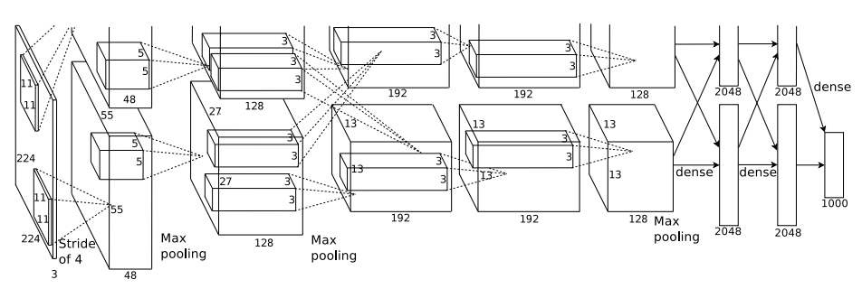
Convolutional Neural Networks architecture - AlexNet
Notes:
The first convolutional layer filters the 224×224×3 input image with 96 kernels of size 11×11×3
with a stride of 4 pixels (this is the distance between the receptive field centers of neighboring
neurons in a kernel map). The second convolutional layer takes as input the (response-normalized
and pooled) output of the first convolutional layer and filters it with 256 kernels of size 5 × 5 × 48.
The third, fourth, and fifth convolutional layers are connected to one another without any intervening
pooling or normalization layers. The third convolutional layer has 384 kernels of size 3 × 3 ×
256 connected to the (normalized, pooled) outputs of the second convolutional layer. The fourth
convolutional layer has 384 kernels of size 3 × 3 × 192 , and the fifth convolutional layer has 256
kernels of size 3 × 3 × 192. The fully-connected layers have 4096 neurons each.

Slide 50
Proposed Ideas
Emotional image captioning
Train multiply rnn model for different emotions (positive, neutral, negative)
Or, add emotion control variables into the model
Combine language model method and syntactic tree/template based language generation method
Use rnn model to generate phrase or segment of sentences
And then use syntactic tree/template to generate final captions

Slide 51
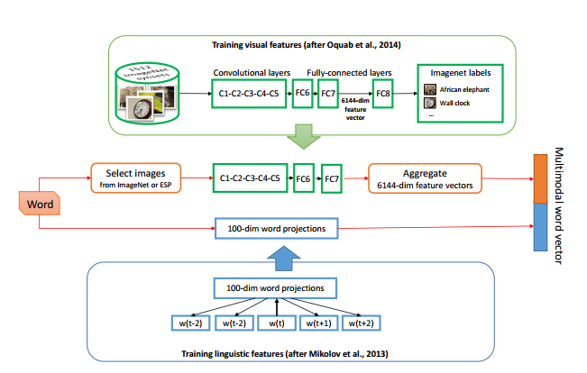
Image-Sentence Embedding
Embedding is learned from Neural Network model
Kiela et al. "Learning image embeddings using convolutional neural networks for improved multi-modal semantics.“ EMNLP 2014.

Slide 52
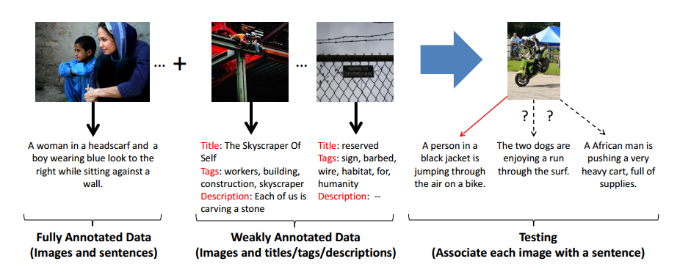
Image-Sentence Embedding
Other ideas in this category:
use large amounts of Flickr images annotated with noisy tags, titles, and descriptions to help with learning of an image-sentence embedding on a small dataset of images and clean ground truth sentences. At test time, we embed images and sentences in the learned latent space and perform image-to-sentence retrieval.
Gong, Yunchao, et al. "Improving image-sentence embeddings using large weakly annotated photo collections." Computer Vision–ECCV 2014

Slide 53
Machine Translation
Generate a rich semantic representation of the visual content including e.g. object and activity labels.
Formulate the generation of natural language as a machine translation problem using the semantic representation as source language and the generated sentences as target language.

Slide 54
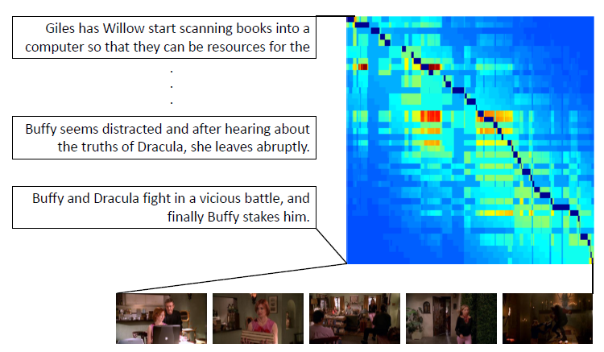
Transcript Alignment
align natural language descriptions of the videos, such as plot synopses, with the corresponding shots in the video.
Guided by subtitles and person identities the alignment problem is formulated as an optimization task over all possible assignments and solved efficiently using dynamic programming
Tapaswi et al. "Story-based Video Retrieval in TV series using Plot Synopses." ACM ICMR 2014.

Slide 55
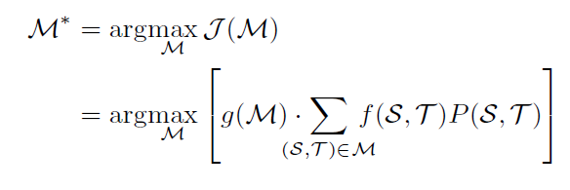
Transcript Alignment
Video is divided into shots
Character Identification (from video and transcript)
Similarity:
Characters similarity
Subtitle similarity
Scene and sentence alignment:

