Slide 1
Scalable Visual Instance Mining with Threads of Features
Wei Zhang, Hongzhi Li, Chong-Wah Ngo, Shih-Fu Chang
City Univeristy of Hong Kong
Columbia University
Notes:
Hello everyone, I’m Hongzhi Li from Columbia University. I’m going to present our work “Scalable Visual Instance Mining with Threads of Features”. This work is done by Wei Zhang from City University of Hong Kong, myself, professor Zong Hua Yang, and professor Shih-Fu Chang.

Slide 2
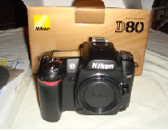
Visual Instance Mining
visual instance: a specific visual entity
object (car, apple, flower)
Landmark, scene
Logo, trademark
Instance Mining: discover frequent visual instances from an image collection
… …
Notes:
First of all, let me define “visual instance”. “Visual instance” refers to specific visual entities, for example, an object, the landmark and scene. Or, it could be logo and trademark. Some examples of visual instance are listed here.
The task we want to solve is to discover the frequent visual instances from an image collection. If we have a large image set, how can we find the popular and important visual instance.

Slide 3
Visual Instances
rare popular
popularity
small large
instance_scale = size of instance / size of image
Notes:
Ok, let’s look into the details of the visual instance. We try to understand this problem by categorizing the visual instances into four different categories according to their scale and popularity.
The x-asix is the instance-scale, which is ratio of the size of instance divided by the size of image, from small to large and the y-asix is the popularity, which measures how many times the visual instance appears in the database, from rare to popular.
Let’s see the upper right corner, there are large and popular visual instances in this area. Most likely, for example, they should be scene pictures, famous landmarks and so on.
On the other side, in the lower left corner, the instances in this area are the small and rare objects. For example, the personal mugs with your own photo on it. It’s hard to find the similar one from others.
Also, a few near duplicate shots may appear in the database, which falls in the right lower corner.
The last category, also the most important on is the small and popular instances in the upper left corner, which could be the objects, logo and trademarks.
We studied the problem to discover both small and large instances as long as they are popular. In the mean while, we pay special attention to small but popular instances.
Next, I’ll review the challenge of this problem and some previous works on this topic as well.

Slide 4
Main Challenge & Related works
Discover small instances in large collection
Previous works against this challenge
Small instance mining
optimization - Tan09; Yuan07; Liu10
frequent itemset mining - Quack08
clustering - Sivic04
hashing: Chum09
frame level instances – mostly landmarks
graph clustering: Philbin08
hashing: Chum10
data-scale
Chum10
Philbin08
Chum09
10⁶
10⁵
10⁴
10³
10²
10¹
Sivic04
Quack08
Liu10
Yuan07
Tan09
large-instance small-instance
mining difficulty
easy hard
Notes:
We identify the most challenging problem is to discover the small instances in the large collection. I’ll take a very straight forward approach as an example to illustrate the challenge. Say, the basic approach could be we use the different scale sliding window to get the patches from every image, and then we compare the patches to find the same or similar one. Of course, we can do clustering as well. But whatever we do, the smaller the target instance is, the more computational cost is needed; the same thing, the larger collection means the more computational cost as well.
Now, let’s review some previous works. We illustrate the related works on the screen. Please see the diagram. The x axis is the size of target instance those works focus on, and the y axis is the data scale they were dealing with. We can see there are some works focus on mining small instance on the relative small dataset. Also, some works focus on dealing with large scale data, but most likely, they only handle the large instance.
Compare to the previous works, our study focus on how to discover the small instance on the large scale data set – the upper left corner of diagram.

Slide 5
Related works
Most popular approach is min-Hash over images (BoW feature)
Efficient: Sub-linear time complexity
Probability of collision = Jaccard similarity (ε) between items
Sensitive to ε: only works for highly similar items
Large number of random collision
not suitable for instance-level mining
Notes:
The most popular way to deal with large scale data set is the min-hash approach over images. As we can see, there are 2 major advantages of hashing approach: first, it’s very efficient, as sub linear time complexity. second, the probability of collision is equal to the Jaccard similarity between items.
Of course, we also noticed some draw backs of hashing approach, for example, it only works for the highly similar items. Due to the sensitive of hash function, the slightly different instances may be mapped to the different buckets. the hashing approach also suffers from the random collision problem, the different instances may be mapped to the same bucket by accident –just because they happen to have the same hash value.
To overcome those drawbacks, we proposed our approach to use min-hash on thread of features, particularly has the better performance on the large scale dataset and small instance mining.
Now, I’ll give you more technical details of our approach, let’s start with the system flowchart.

Slide 6
System Overview
Dataset
ToF: Thread of Features
Instance Clusters
Multimedia
Summarization
Applications
Instance
Search
Feature Detection
Feature Threading
Thread Clustering
Cluster Voting
Notes:
Here, I only give the high level overview of our approach, I’ll introduce each component later.
Given the data set, we extract SIFT features from images, and then find the “thread of feature” from the image collection, I’ll give you the definition of “thread of feature” in the next slides.
After we get feature thread, we will cluster the threads and use the cluster to find the instances as the cluster voting step.
this approach could be applied to several applications, like multimedia summarization and instance search.

Slide 7
Feature Threading
Thread of Feature(ToF) is a set of consistent features across different images
ToF is represented as a set of image ids
Speed up Feature-Threading: Hamming codes for early pruning
Notes:
The first component in our system is feature threading, we call thread of feature as ToF for short. And a ToF is a set of consistent features linked across different images. It is represented as a set of image ids. As we can see the example images on the screen, there are three pictures, and we find three ToFs over the images, the grey line, the blue line and the red line. Each line linked the set of consistent features.
Finding the ToF is motivated by the fact that only a very small fraction of local features, which are likely to repeat among images and helpful in instance mining. We highlight these features by threading them together. By doing so, large number of background features are excluded from mining.
ToF serves as an important cue for identifying frequent instances. Whenever there is an instance among a set of images, there must be several ToFs connecting these images. On the other hand, most likely, there is no ToF among random images which don’t have the common instance.
In our work, we quantize the raw SIFT features to visual words. Considering the quantization error, to quantize the local feature to the same visual word doesn’t mean that the correspondent visual content is the same. So, instead of relaying on the single SIFT feature, we also consider the surrounding features around each central feature for accuracy matching.
Two features are threaded if their local patches shared at least 2 common visual words.
We noticed that, even for features quantized to the same visual word, most of the similarity evaluations are still unnecessary. We use hash to speed up the feature-threading. By calculating a short binary hamming signature for each central feature, we reduce about 99% similarity evaluations compared to the previous work. Hamming distance is checked prior to the actual similarity evaluation. Only features with low Hamming distance are subject to do actual similarity evaluation. Note that comparing to full similarity evaluation, hamming distance is much efficient (as “XOR” op.) to compute.

Slide 8
Feature Threading
one ToF corresponds to a set of reliably matched local patches.
Two local patches are linked by one ToF when:
The central features are quantized to the same visual word
small Hamming distances for their signatures
roughly consistent neighborhood
Notes:
In summary, one ToF corresponds to a set of reliably matched local patches.
And two local patches are linked by one ToF if the central features are quantized to the same visual word, and small Hamming distances for their signatures; also, they have roughly consistent neighborhood.
ToF serves as a reliable link connecting images sharing consistent features. In practice, only a small fraction of features are linked as threads, while large portion features are discarded as noises. Compared to traditional BoW, ToFs are much smaller in size and cleaner in quality, which enables efficient and reliable instance mining in large dataset.

Slide 9
Thread Clustering
Each ToF -> a link over a set of images Ω
Multiple ToFs -> a strong link over Ω -> a pattern (an instance)
Min-Hash for thread clustering
Notes:
After we find the thread of features, we start to use the thread of features to find the instances.
For example, each ToF means we find a link over a set of images. If we find multiple ToFs over the same set of images, which means we find the strong link over that set of images, which is a pattern, or the visual instance. (Optional: Also, isolated ToF means a noisy link, most likely. )
The way we find the multiple ToFs over the image set omega is to cluster the threads. Remember, the thread is represented by a set of image Ids. So we use min-Hash for the thread clustering.
Comparing to the traditional work which cluster over images, we do clustering over thread of features, which significantly boosts the performance, in terms of the speed and the chance to find the small instance.

Slide 10
Min-Hash used for ToF clustering
Collision probability is independent from instance scale
Min-Hash is good for ToF clustering:
background features are discarded while threading
High similarity between threads over the same instance, even for small instances
Notes:
We use min-hash for our clustering because, First, we found that the collision probability is independent from instance scale. This property is important because it gives us the capability to mine the small instances better.
On the other hand, min-hash approach also benefits from the properties of ToF. For example, the background features are discarded while threading, which makes ToF much cleaner.
We also overcome the random collision issue, or we call it false positive. That is the different items are mapped to the same cluster by error. We find the probability to get false positive for min-Hash over ToF is much smaller than to do it over images. There is some theoretical analysis regarding this issue, which could be find in our paper section 3.2, but for time, I won’t discuss it here.
Next, I’m going explain our experiments setup and the results.

Slide 11
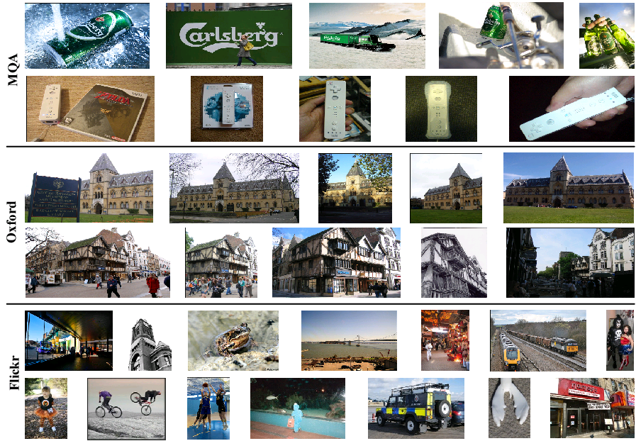
Experiments - dataset
Annotated dataset
MQA
small objects
Oxford
Oxford5k: 11 landmarks + 353 our annotated instances
Oxford105k: distracting images
Blind real-world dataset
Flickr1M
randomly crawled for scalability test
no ground-truth
Notes:
We used three dataset to test and demonstrate our approach, they are MQA, oxford and flickr 1M. MQA is a dataset with fully annotated small objects. Oxford 5k dataset has 11 landmarks as the given ground truth and we also manually annotated another 353 instances. We tested our work on oxford 100k dataset, which added about 100k distracting images to the oxford 5k dataset.
We used MQA dataset to test the performance of mining small objects, and used Oxford dataset to test the performance of mining large objects.
We also tested our system’s capability of dealing with large scale data by Flickr1M dataset, which has about 1M images crawled from flickr. Unfortunately, we don’t have the ground truth for this dataset, but we can see the efficiency of our approach and get the reasonable mining results. I’ll show some instances found from this dataset.
We used the standard precision, recall and f1 score to measure our system. Please note that we use image pair as the basic unit when we calculate the measurement. For example, the precision is the number of true image pairs divided by the number of detected image pairs. The true image pair means the two images in the pair contain the same visual instance.

Slide 12
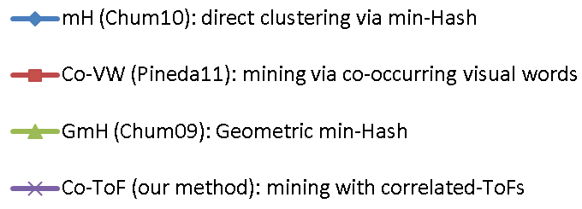
Performance comparison
MQA
Oxford105k
instances: small objects landmarks
Co-ToF is less-sensitive to instance scale
Co-ToF produces less random-collisions as dataset grow
Co-ToF needs fewer hash tables to saturate its performance
Notes:
We compared 4 methods with F-measure. The purple curve is our approach, compare to the min-hash approach as the blue curve, co-occurring visual words approach as the red curve and geometric min-Hash approach as the blue curve. The x axis is the size of hash tables and the y axis is the f1 score.
Here, I want to claim three advantages of our approach:
First, we noticed that MQA data set contains relative small instances, and oxford dataset has large instances, like landmarks. From the performance figures, we can see our approach is less-sensitive to the instance scale.
Second, given the fact that MQA dataset has 438 images and oxford dataset has 105k images, our method produces less random-collisions as dataset grows. As we can see, our approach still achieve the good performance on the large dataset, in the mean while, the other approaches works better on the related small dataset comparing to the large dataset.
Third, our approach needs fewer hash tables to saturate the performance. Our method converges fast to its best performance, using only a few hash table, while other methods generally needs significantly more hash tables to get reasonable results.

Slide 13
Performance – with 20 hash tables
Detailed performance using 20 hash tables
MQA
Oxford105k
Notes:
Here, I give you more detailed performance comparison by using only 20 hash tables. The precision, recall and F-measure. Our method, the purple one, shows clear advantage.

Slide 14
Mining in Flickr1M
Dart board
Starbucks
Logo in corner
Apple logo
Adidas
Border style
Precision of the mining results for Flickr1M, estimated on 1000 random image pairs.
Notes:
Here is some instances we mined from Flickr1M dataset. As we can see Dart board in the first row, starbucks logo in the second row and so on.

Slide 15
App 1: Multimedia Summarization
Task
summarize multimedia collections
Dataset
Crawl videos from Youtube by keyword search
Keyword 1: “Boston Bombing” → 355 videos
Keyword 2: “Malaysia Airlines Flight 370” → 406 videos
Notes:
As I promised at the beginning of the presentation, I’ll show you some potential applications.
The first one is multimedia summarization. The task of this application is to summarize multimedia collections. Our solution is to summarize them by visual instances.
We build a dataset to demonstrate this application. The dataset is built by crawling videos from YouTube with keyword search. In this particular example, we use “Boston Bombing” and “Malaysia Airlines Flight 370” as the query.

Slide 16
Boston Bombing
App 1: Multimedia Summarization
Malaysia Airlines 370
Notes:
And here is the visual summarization of those two examples. We put the text summarization on the top. Compare to the general, abstract text summarization, the visual instance summarization has more concrete, vivid and intuitive information about Who, what, where (how) the event happened
Comparing to the traditional frame level summarization, -- we know we used to select important frames to summarize the videos --, the instance level summarization give the user key information, like the key face, key object and so on.

Slide 17
App 2: Instance Search
Does “offline links” help “online query”?
offline links: constructed via Instance Mining
Solution
re-rank based on offline links
Tested on TRECVID’13 Instance Search task
30 queries
76,751 video clips
800, 000 frames
query obj
Dataset
1
2
3
rank: 1
…
300
rank: 300
…
Notes:
We give the second application example here, instance search.
The motivation is: does “offline links” help online query? Offline links here, are constructed by instance mining.
Our solution is to do re-ranking based on offline links. We tested our method on TRECVID’13 instance search task.
In this task, there are 30 queries, 76 thousands video clips and 800 thousands frames.

Slide 18
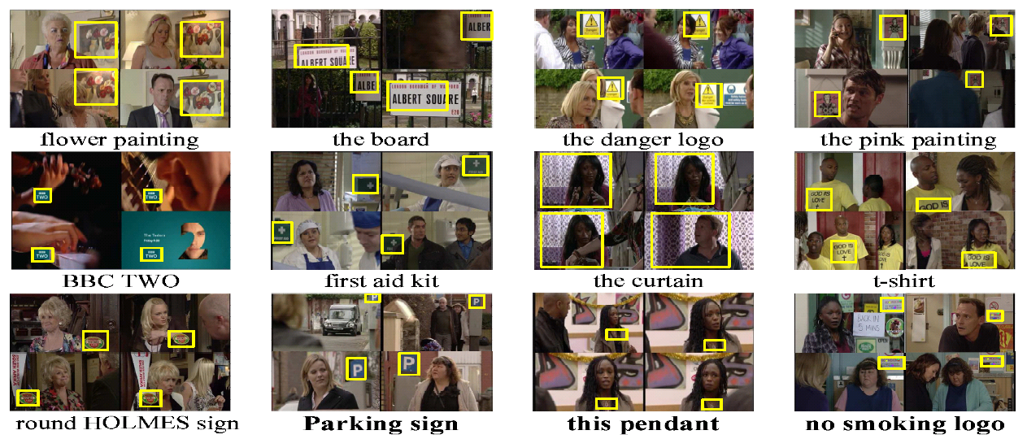
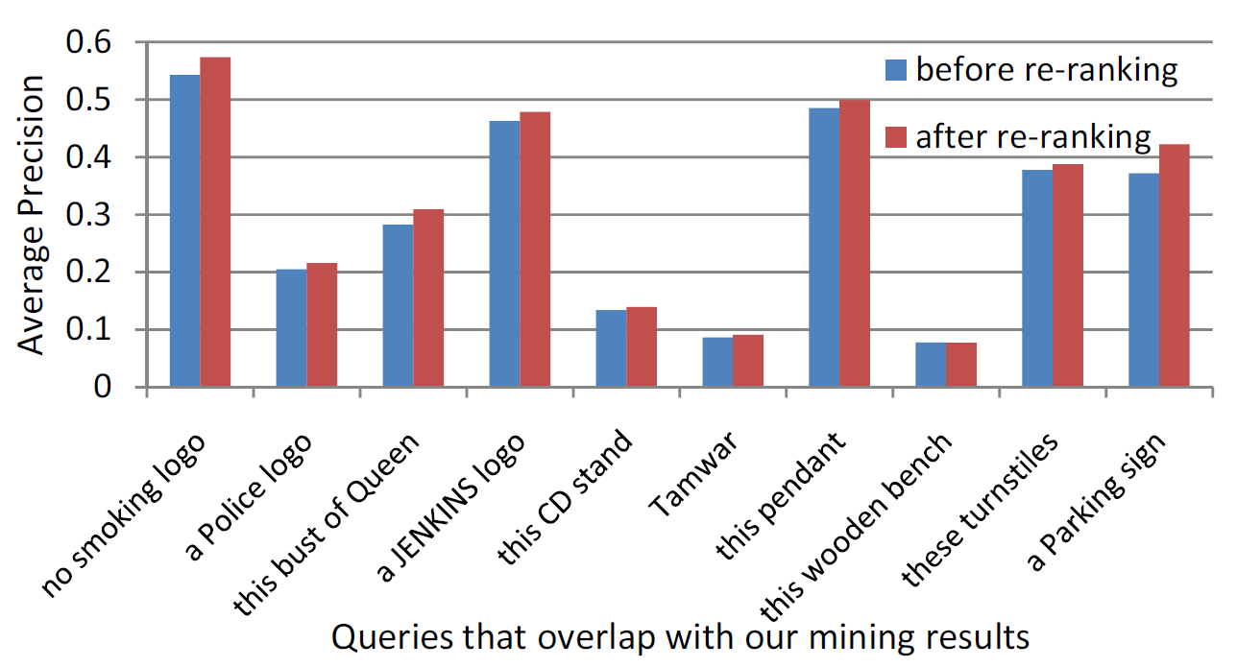
Notes:
We show some of the instances mined by our system. And here is the performance gain before-and-after re-ranking.

Slide 19
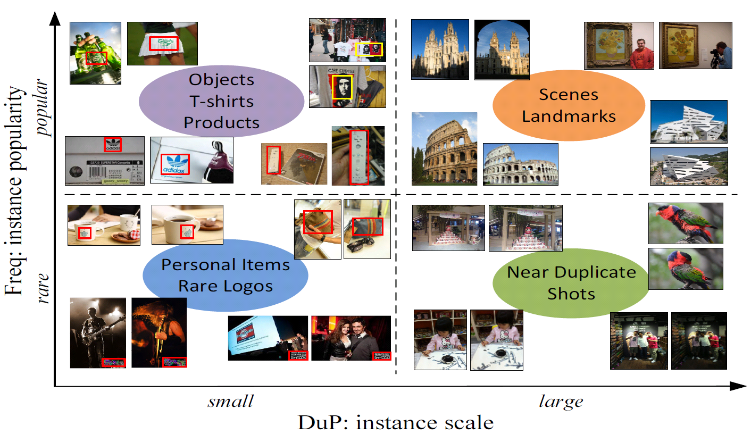
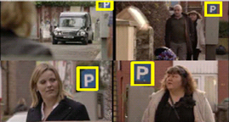
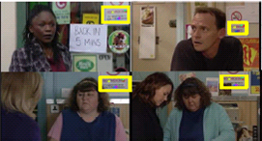
Summary
Visual Instance Mining
Mining small instances in large dataset
Thread of Features (ToF)
New perspectives for timely multimedia problems
Instance-level summarization
Instance search
Notes:
As wrap up, I’ll summarize this presentation. We developed an efficient approach to mine the visual instance and we want to highlight the capability of mining small instances in the large dataset. And our approach could be potentially applied to several applications, to solve some multimedia problems, like instance-level summarization, instance search.
Thank you so much, and if you have any question. I’m more than happy to take it.

Slide 20
Thank You!

Slide 21
ToFs Clustering
min-Hash for efficient clustering
near O(n) in time complexity
prob. of collision = Jaccard similarity of items
Why cluster ToFs instead of images
clustering images
find near duplicate images
miss small instances
clustering threads (ToFs)
collision prob. is independent to instance scale
needs fewer hash tables
Notes:
Move forward this slide. Cuz this has the motivation

Slide 22
Details on each dataset

Slide 23
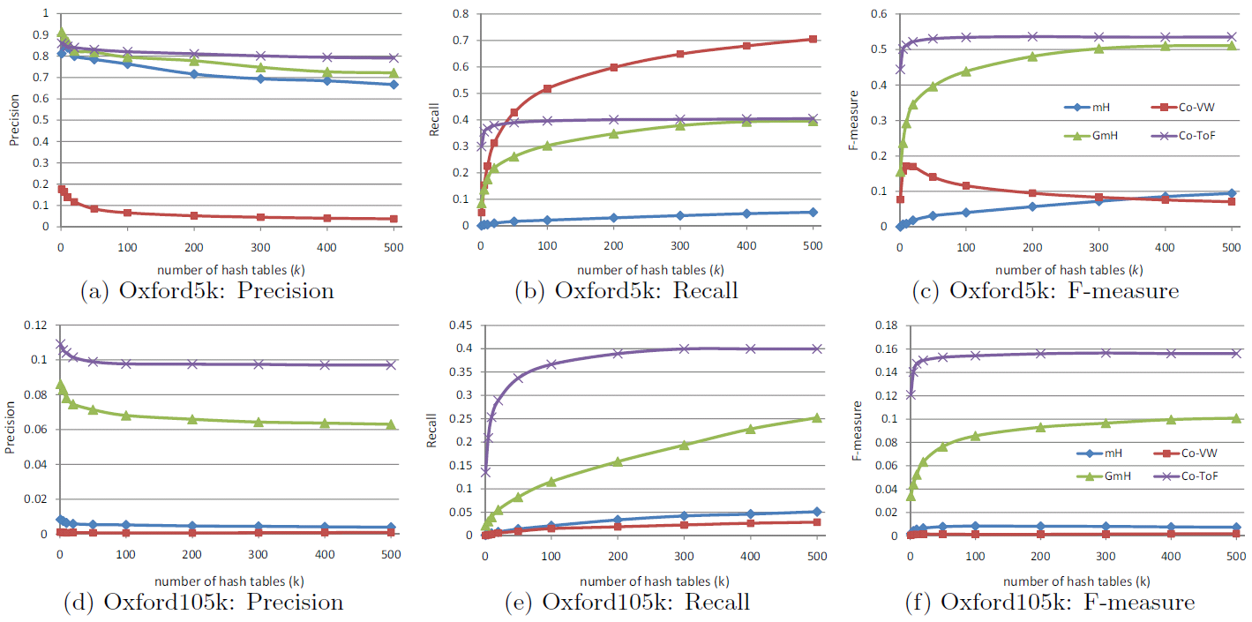
Mining Result - Oxford

Slide 24
Performance on Small Instances
Only evaluate on small instances
split instances into halves
364 instance clusters = 182 smaller + 182 larger instances
F-measure on the “smaller” subset of instances in Oxford dataset

Slide 25
Outline
Introduction
Main challenge
Our solution
Applications
Notes:
Today’s talk will follow this outline. I’ll describe the main challenge we want to solve and give our solution. At the end, I’ll give some potential applications which our algorithm could be applied to.

Slide 26
Feature Threading
Compact: only link potential features from instances;
Complete: cover as many instances as possible;
Efficient: be scalable on large dataset.
Notes:
The thread of features should be compact, only link potential features from instances, should be complete, to cover as many instances as possible, should be efficient, to be scalable on large dataset.

Slide 27
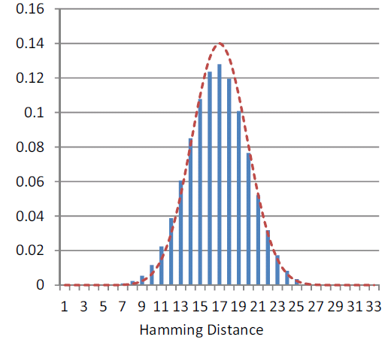
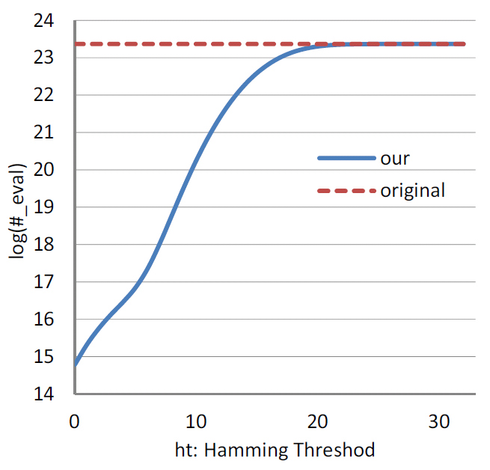
Speed up Feature-Threading
Hamming codes for early pruning
reduce ~99% similarity evaluations compared with Sivic04
Notes:
We noticed that, even for features quantized to the same visual word, most of the similarity evaluations are still unnecessary. We use hash to speed up the feature-threading. By calculating a short binary hamming signature for each central feature, we reduce about 99% similarity evaluations compared to the previous work. Hamming distance is checked prior to the actual similarity evaluation. Only features with low Hamming distance are subject to do actual similarity evaluation. Note that comparing to full similarity evaluation, hamming distance is much efficient (as “XOR” op.) to compute.
For the mathematical details, please refer to section 3.1 in our paper. I won’t discuss too much here.
The left diagram shows the distribution of Hamming Distance. X axis is the hamming distance. The y axis is how many feature pairs with the correspondent hamming distance appears in the dataset. (Basically, it is drawn from binomial distribution. )
The right diagram illustrates the efficiency of our approach. The x axis is the threshold we used, we evaluate the similarity of two features only if their hamming distance is smaller than that threshold. The y axis is the log scale of the number of evaluations we need to do to find the thread of features. From this figure we can see, if we set a relative small hamming threshold, we can significantly reduce the number of evaluations we need to do.

Slide 28
Feature Threading
Two local patches are linked by one ToF when:
The central features are quantized to the same visual word
small Hamming distances for their signatures
roughly consistent neighborhood
Notes:
In summary, one ToF corresponds to a set of reliably matched local patches.
And two local patches are linked by one ToF if the central features are quantized to the same visual word, and small Hamming distances for their signatures; also, they have roughly consistent neighborhood.
ToF serves as a reliable link connecting images sharing consistent features. In practice, only a small fraction of features are linked as threads, while large portion features are discarded as noises. Compared to traditional BoW, ToFs are much smaller in size and cleaner in quality, which enables efficient and reliable instance mining in large dataset.

Slide 29
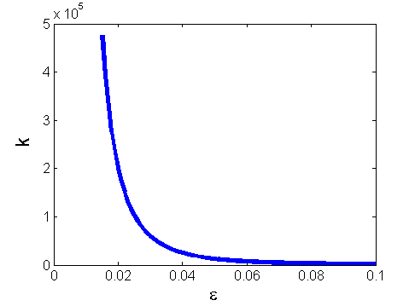
Min-Hash used for ToF clustering
fewer hash tables required
k: # hash tables required to get the success rate (a) for collision
number of required hash tables is highly sensitive to the similarity between true positive items (ε)
k versus ε when a = 80%
Notes:
The other advantage of our approach is that fewer hash tables are needed. Let’s say, K is the number of hash tables required to get the success rate a for collision.
and K should be bigger then the log 1 minus alpha to the base 1 minus epsilon to the power s
The diagram shows the k versus epsilon when alpha is set to zero point eight. This epsilon is the similarity between the true positive image pair.

Slide 30
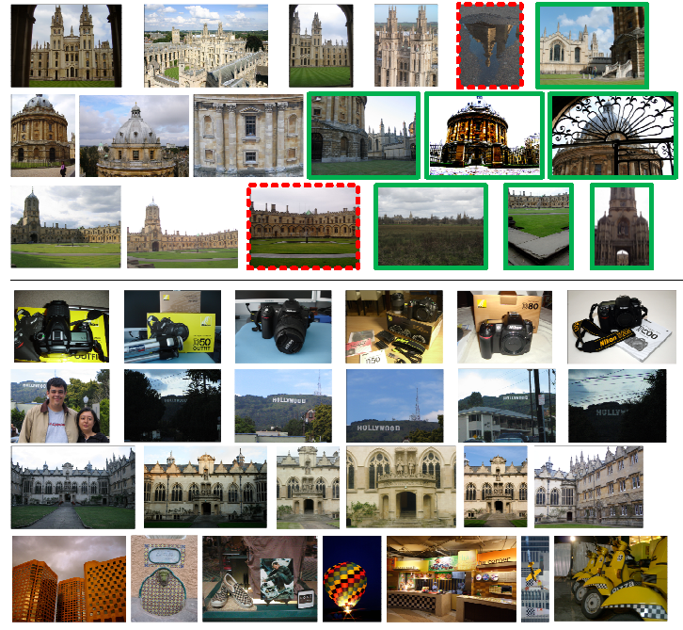
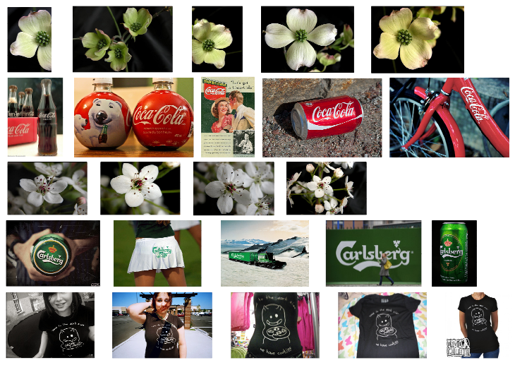
Example Instances Mined
MQA
Oxford
Flickr
Notes:
We used the standard precision, recall and f1 score to measure our system. Please note that we use image pair as the basic unit when we calculate the measurement. For example, the precision is the number of true image pairs divided by the number of detected image pairs. The true image pair means the two images in the pair contain the same visual instance.

Slide 31
Examples instances - Oxford
False alarm
mined instances among the 11 landmarks
“Junk” objects
Junk - Less than 25% of the object is visible, or there are very high levels of occlusion or distortion.
mined instances in our own annotation
Notes:
At the end, I’ll show you some examples. This is the example instances we mined from oxford dataset.
The upper portion shows the mined instances among the 11 landmarks. And the lower portion shows the instances in our own annotation.

